Slide 1
Lending Club Analysis Case Study
Shakeeb Pasha and Vishal Khera

Slide 2
Agenda
1. Objectives
2. Insights & Assumptions
3. Recommendations
4. Appendix
Approach and Findings

Slide 3
Objective

Slide 4
Object
We have been given the complete loan data for all loans issued through 2007 to 2011 for Lending Club
We need to surface insights based on the available information with the objective to
Reduce losses for the business by improving the probability of identifying
Applicants that may not be able to pay back loans
Applicants that have a strong possibility of paying back loans

Slide 5
Insights and Recommendations Cheat Sheet
The insights provided in the following slides can be used as a cheat sheet to identify the risk potential of loan applications.

Slide 6
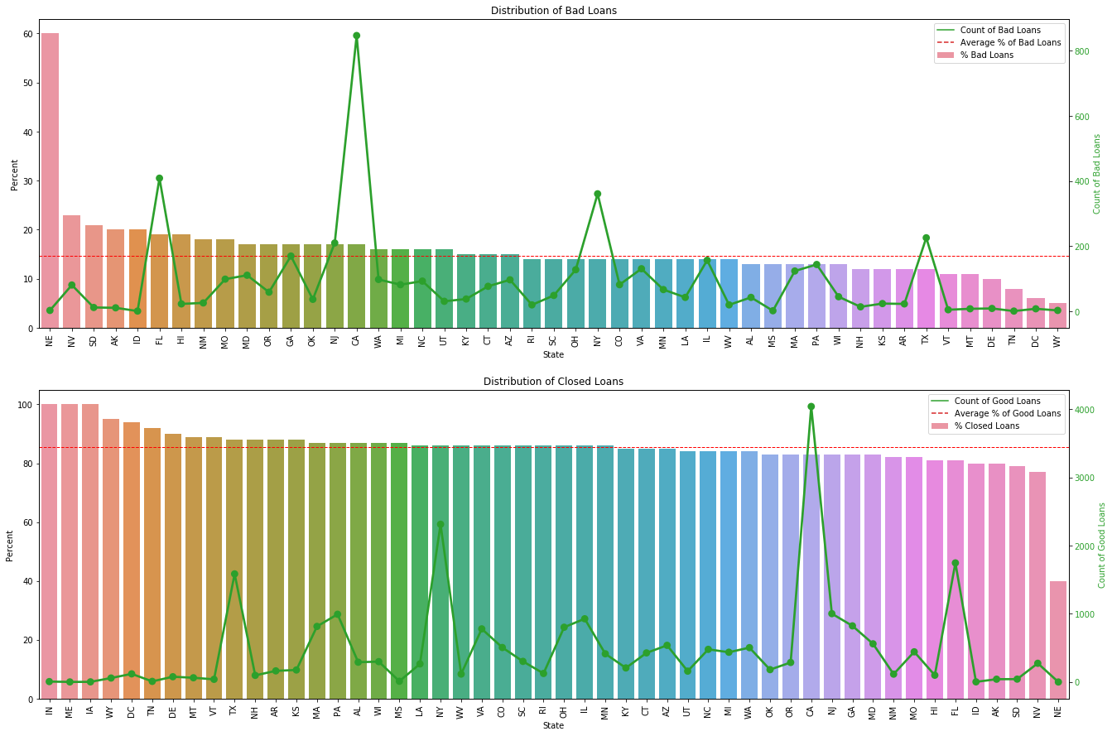
Segmented Univariate | Insights
High volume and higher than average bad loans are coming from FL, NJ, CA.
NE, NV, AK, SD, are also high in their default rate even though the numbers are less
NY, TX are good for Lending Club where the volumes are there and the default rates are low

Slide 7
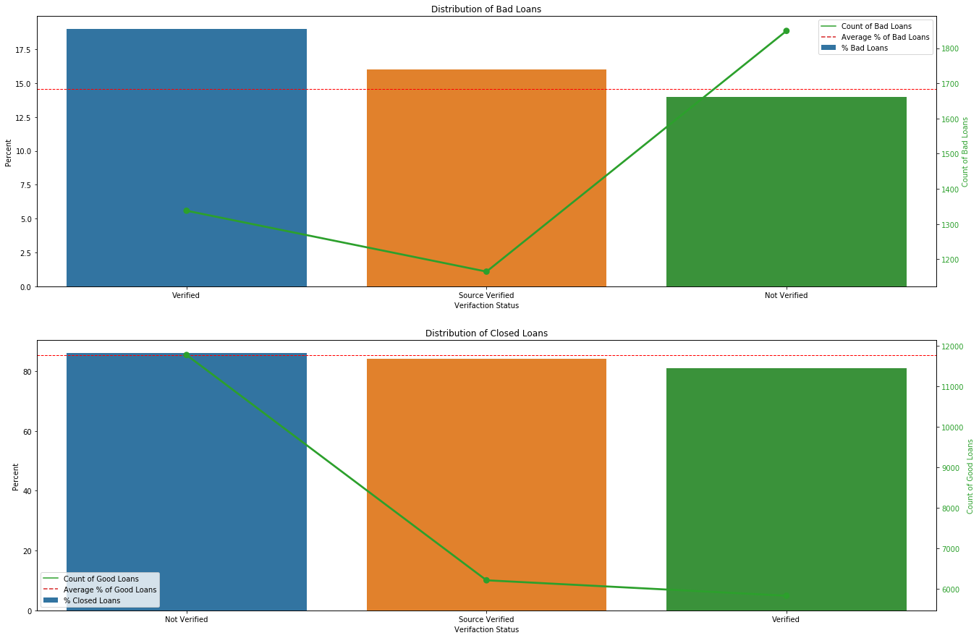
Segmented Univariate | Insights
Verified applicants seem to have a have higher default rate! than not verified ones.

Slide 8
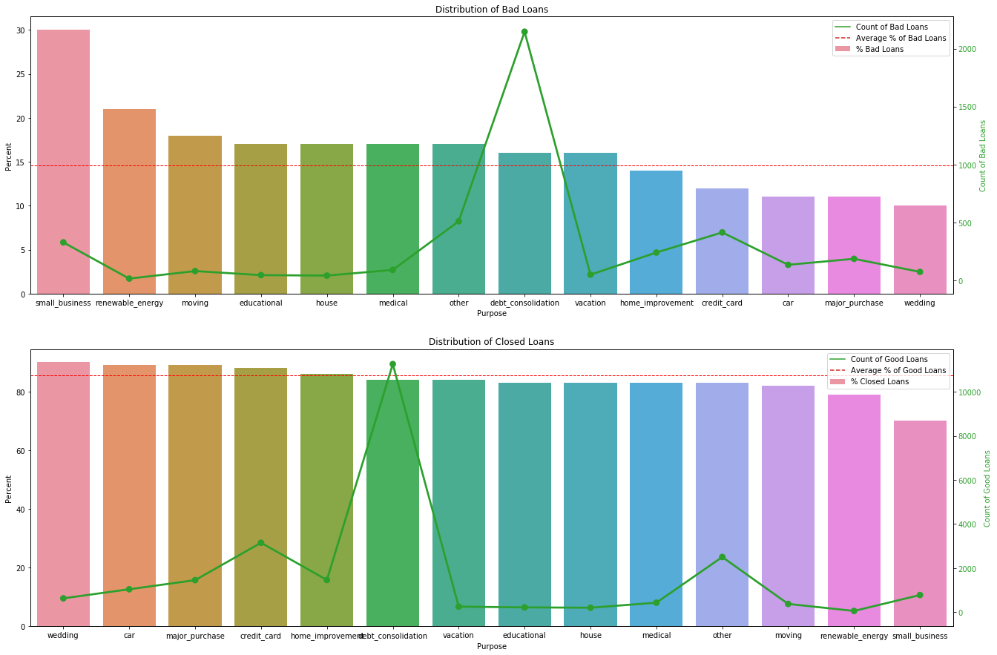
Segmented Univariate | Insights
Small business loans have the higher % of loans going bad and debt consolidation is the highest in terms of volumes but highest in terms of number of bad loans

Slide 9
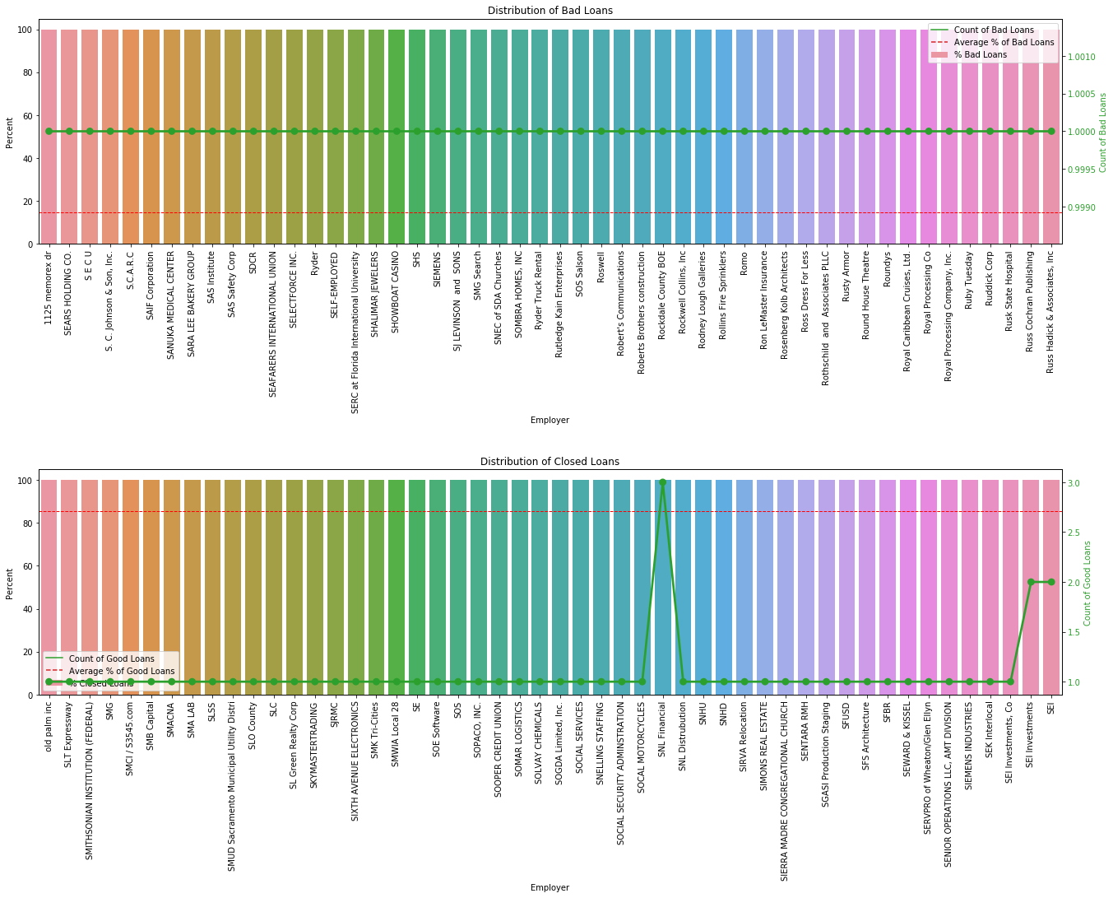
Segmented Univariate | Insights
On backgrounds of people, it is very scattered, however there are people working for companies and those companies have 100% default rate or 100% closed rate. Clearly company background though less volumes is a good predictor of bad loan
Longer tenured loans have higher default rate
%age wise “no available information” on current employee length seems to have the highest default rate. However the 10+ years seems to have a higher than average default rate with good volumes.
Only A and B graded loans have the average default rates lower than average and the volumes of B is the highest in disbursement
People with 0 Public records have the lowest default rates

Slide 10
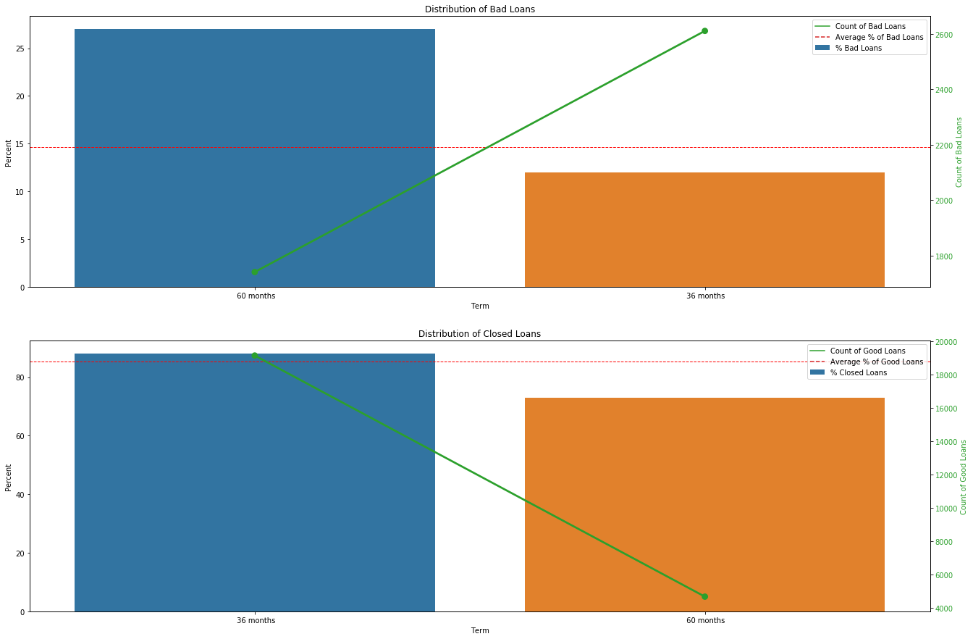
Segmented Univariate | Insights
Longer tenured loans have higher default rate

Slide 11
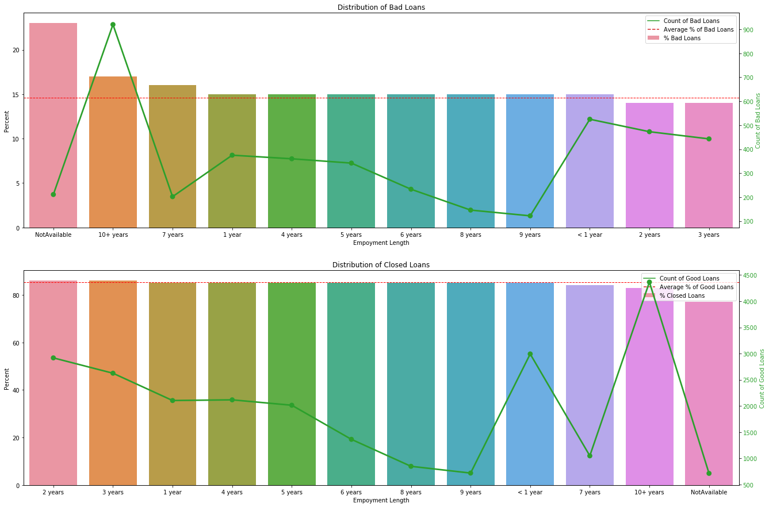
Segmented Univariate | Insights
%age wise “no available information” on current employee length seems to have the highest default rate.
However the 10+ years seems to have a higher than average default rate with good volumes.

Slide 12
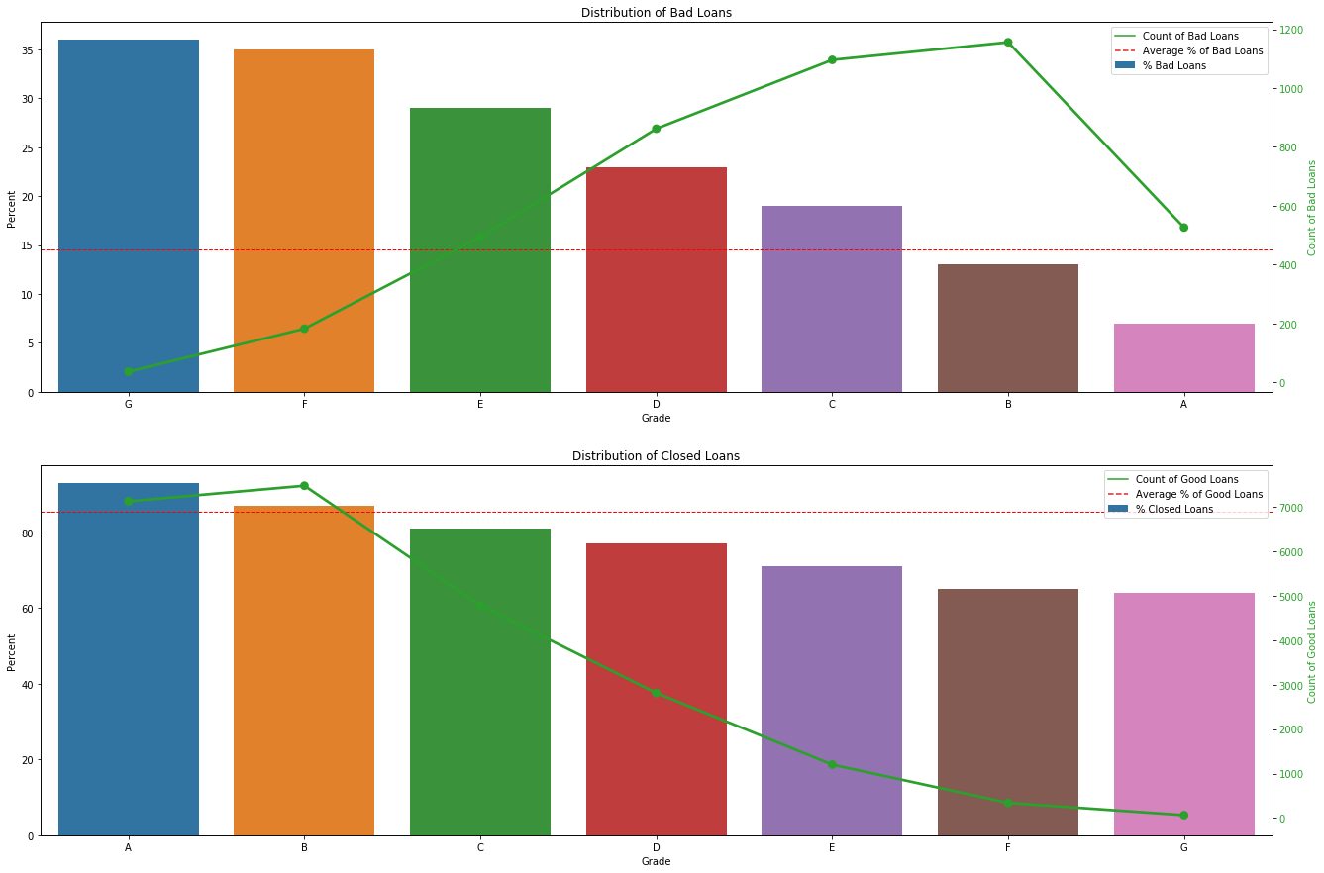
Segmented Univariate | Insights
Only A and B graded loans have the average default rates lower than average and the volumes of B is the highest in disbursement

Slide 13
Bivariate Analysis | Cheat Sheet on States
The following table shows Good Loans with 90+% probability of being closed with no default (green) and Bad loans with 25% probability or more of going bad (amber) against
State and House ownership of the applicant
State and Public records of the applicant
Clearly some of the States are good such as IN, IA that irrespective of other parameters they probabilities are good and other states like NE, NV which have higher than default rates.

Slide 14
Bivariate Analysis | Cheat Sheet on Loan Purpose
The following table shows Good Loans with 90+% probability of being closed with no default (green) and Bad loans with 25% probability or more of going bad (amber) against
Loan Purpose and Loan Amount
Loan Purpose and Rating of the Loan applicant
Clearly house loan seems to be the least risk followed by wedding and loans to small business carries the highest default rate.
Best track record is in Grade A loans and the changes of bad loans worsens with fall in Applicant’s Grade

Slide 15
Bivariate Analysis | Cheat Sheet on Loan Purpose - 2
The following table shows Good Loans with 90+% probability of being closed with no default (green) and Bad loans with 25% probability or more of going bad (amber) against
Loan Purpose and House Ownership
Loan Purpose and Length of Employment in last organization
Loan Purpose and N. of Public records
Reinforces the previous finding that
small business is a problem irrespective of any other parameter and
credit card loans is safe for people working in organizations where we have details of employee length.

Slide 16
Bivariate Analysis | Cheat Sheet on Loan Purpose - 3
The following table shows Good Loans with 90+% probability of being closed with no default (green) and Bad loans with 25% probability or more of going bad (amber) against
Loan Purpose and House Ownership
Loan Purpose and Length of Employment in last organization
Loan Purpose and No. of Public records
Reinforces the previous finding that
small business is a problem irrespective of any other parameter and
credit card loans is safe for people working in organizations where we have details of employee length.

Slide 17
Bivariate Analysis | Cheat Sheet on Loan Amounts
The following table shows Good Loans with 90+% probability of being closed with no default (green) and Bad loans with 25% probability or more of going bad (amber) against
Loan Amount Length of Employment in last organization
Loan Amount and Grading of the Loan
Reinforces the fact that
Higher loans have higher default rates and
Lower grade applicants have higher rate of default.
Grade A applicants seem to be the best in terms of closure rate

Slide 18
Bivariate Analysis | Misc.
The following table shows Good Loans with 90+% probability of being closed with no default (green) and Bad loans with 25% probability or more of going bad (amber) against
Grade of Applicant’s loan and no. of 30+ days past-due incidences of delinquency in the borrower's credit file for the past 2 years
Verification Status and no. of 30+ days past-due incidences of delinquency in the borrower's credit file for the past 2 years
Employee Length and the duration of the loan
Reinforces the fact that
Lower grade loans have higher default rates irrespective of the delinquency number
From 3 and above Delinquency rate we see it impacts the loan going bad irrespective of the Verification status
Higher tenured loan has a higher default rate than lower tenured loans.

Slide 19
Appendix
Approach

Slide 20
Approach
Import Data from csv
Understand the Data Types and Shape
Data Clean up - 1
Convert % into numbers
Bivariate Analysis
Data Understanding
Remove unused columns (e.g. URL, description)
Potentially 2 Imputes values based on mean, median or mode (not done)
Univariate Analysis
Categorizing variables based on (see Note-1)
Applicant Related
Loan Characteristics
Customer Behaviour
Drop all behaviour related columns as these are not used for loan processing, these come after loan has been issued.
Identify target column for analysis (loan status)
Data Clean up - 2
Identify and Remove missing columns (assumption 50% and above empty)
Drop duplicate rows if any
Remove columns that have 0 as a value across all rows
Remove columns with single value across all rows (5 columns identified)
Remove columns with single value across all rows (5 columns identified)
Drop “current” loans given we are not sure if these will go bad or not. Not relevant for study.
Categorize all variables into (see Note-2)
Not Relevant
Unordered
Ordered and
Continuous
Drop all the ‘Not Relevant; columns
Carry out Segmented Univariate Analysis for Bad loans and Good loans and search for Insights
Plot graphs of the Ordered categorical variables and search for insights
Plot graphs of the unordered categorical variables and search for insights
Plot Histograms for continuous variables and search for insights
Get Heatmap on the correlation b/w the columns and identify insights on correlation
Select subset of columns for Bivariate analysis
Apply heatmaps on paired columns for bivariate analysis and search for insights
Apply Category codes for unordered columns e.g. State, verification status, purpose, grade, month, home ownership, term, emp_length…
Keep single column among the high correlated sets of data and drop the others in that set.
Get Pair plot on the variables to see if there are any relationships

Slide 21
Note – 1 : Segregation of Columns
Application Related
Loan Characteristics
Customer behaviour
id
member_id
emp_title
emp_length
home_ownership
annual_inc
title
zip_code
addr_state
earliest_cr_line
delinq_2yrs
inq_last_6mths
open_acc
pub_rec
total_acc
pub_rec_bankruptcies
loan_amnt
funded_amnt
funded_amnt_inv
term
int_rate
installment
grade
sub_grade
verification_status
issue_d
loan_status
purpose
dti
out_prncp
out_prncp_inv
total_pymnt
total_pymnt_inv
total_rec_prncp
total_rec_int
total_rec_late_fee
recoveries
collection_recovery_fee
last_pymnt_d
last_pymnt_amnt
last_credit_pull_d
revol_bal
revol_utl

Slide 22
Note – 2 : Segregation of Variables
Not relevant
unordered
ordered
Continuous
id
member_id
earliest_cr_line
zip_code
title
addr_state
verification_status
total_acc
purpose
home_ownership
emp_title
term
emp_length
Grade
sub_grade
loan_status
pub_rec
issue_d
inq_last_6mths
pub_rec_bankruptcies
delinq_2yrs
open_acc
int_rate
loan_amnt
installment
dti
funded_amnt
funded_amnt_inv
annual_inc

Slide 23
Univariate Analysis | Insights
Unordered Categorical
Majority of the Club’s business is in 10 states
A significant portion of the loans show as non-verified
Majority of loans taken are for Debt Consolidation
Majority of loans taken are by people with rented / mortgaged homes
The number of credit lines on the Borrower's file follows a standard distribution
Ordered Categorical
Almost 75% of the loans are of tenure 36 months
Majority of Loans are given to people with jobs. There are close to 1000 people who have not disclosed or are not in jobs
Majority of loans are with A,B and C gradings
Further breakdown by sub grade shows D, E and F grades are not encouraged with the outlier of D2 which seems to be high in comparison
Employee Title Contains too much text, no processing done on this column
85.4% of loans closed have been fully paid up, 14.6% of loans have gone bad
We have about 2100 cases with derogatory public records which is a little over 5% of the population.
No real abnormal patterns seen in the distribution of loans by month
Not many loan applications with more than 3 inquiries were approved
About 94% of the loans were given to applicants with 0 public record bankruptcies and about 4% with 1 record
About 2.5% of the applicants given loan have had over 1 incident of delinquency in the last 2 years
The number of credit lines on the Borrower's file follows a standard distribution

Slide 24
Univariate Analysis | Insights contd.
Segmented
High volume and higher than average bad loans are coming from FL, NJ, CA.
NE, NV, AK, SD, are also high in their default rate even though the numbers are less
NY, TX are good for Lending Club where the volumes are there and the default rates are low
Verified applicants seem to have a have higher default rate! than not verified ones.
Small business loans have the higher % of loans going bad and debt consolidation is the highest in terms of volumes but highest in terms of number of bad loans
People who have mortgaged houses seem to have lesser rate of default
On backgrounds of people, it is very scattered, however there are people working for companies and those companies have 100% default rate or 100% closed rate. Clearly company background though less volumes is a good indicator of bad loan
Longer tenured loans have higher default rate
%age wise “no available information” on current employee length seems to have the highest default rate. However the 10+ years seems to have a higher than average default rate with good volumes.
Only A and B graded loans have the average default rates lower than average and the volumes of B is the highest in disbursement
People with 0 Public records have the lowest default rates

Slide 25
Bivariate Analysis | Insights
Correlation Analysis
From the calculated Correlation coefficients we see strong correlation seen b/w
Number of derogatory public records (pub_rec) and Number of public record bankruptcies (pub_rec_bankruptcies)
Loan amount applied (loan_amnt) and monthly installment by the borrower (installment)
Loan amount applied (loan_amnt) and the committed Funding amount (funded_amnt)
Loan amount applied (loan_amnt) and committed funding amount by the investors (funded_amnt_inv)
Committed Funding amount (funded_amnt) and committed funding amount by the investors (funded_amnt_inv)
Monthly installment by the borrower (installment) and committed funding amount by the investors (funded_amnt_inv)
Paired Bivariate Analysis (90%+ confidence for Bad Loans)
From the various heatmap plots we see
States of AR / Others have a 90% of going bad
States of CT / Others have a 100% of being good
States of DC / Others have a 100% of being good
States of DC / Mortgages have a 100% of being good
States of DC / Others have a 100% of being good
States of DC / Own have a 100% of being good
States of DC / Rent have a 92% of being good
States of DE / Own have a 100% of being good
States of HI / Mortgages have a 90% of being good
States of IA / Mortgages have a 100% of being good
States of IA / Own have a 100% of being good
States of IA / Rent have a 100% of being good
States of ID / Own have a 90% of being good

